Slide 1


Machine Learning on Salary Prediction
RMS

Slide 2

Problem Statement:
Salaries in the field of data professions vary widely based on factors such as experience, job role, and performance. Accurately predicting salaries for data professionals is essential for both job seekers and employers.

Slide 3
Mission of the project
1. EDA
2. Feature Engineering
3. Data Preprocessing
4. Machine Learning Model Development
5. Model Evaluation
6. ML Pipelines and Model Deployment

Slide 4
Dataset Overview
`FIRST NAME`: First name
`LAST NAME`: Last name
`SEX`: Gender
`DOJ`: Date of joining the company
`CURRENT DATE`: Current date of data
`DESIGNATION`: Job role/designation
`AGE`: Age
`SALARY`: Target variable, the salary of the data professional
`UNIT`: Business unit or department
`LEAVES USED`: Number of leaves used
`LEAVES REMAINING`: Number of leaves remaining
`RATINGS`: Ratings or performance ratings
`PAST EXP`: Past work experience

Slide 5
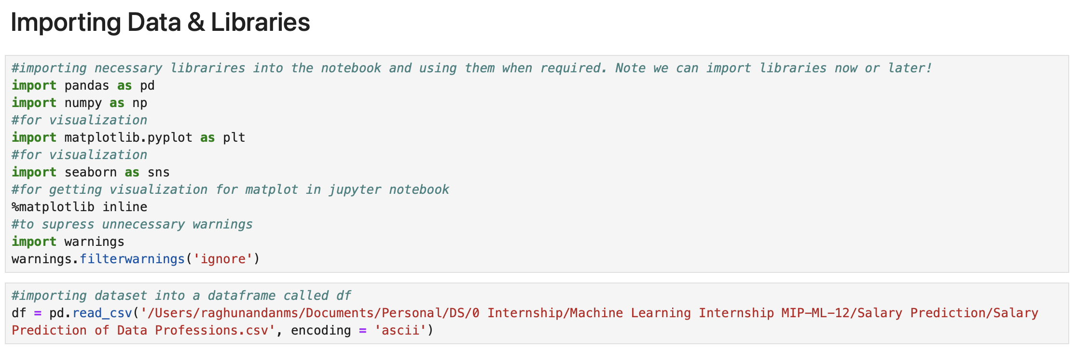
Importing the data

Slide 6
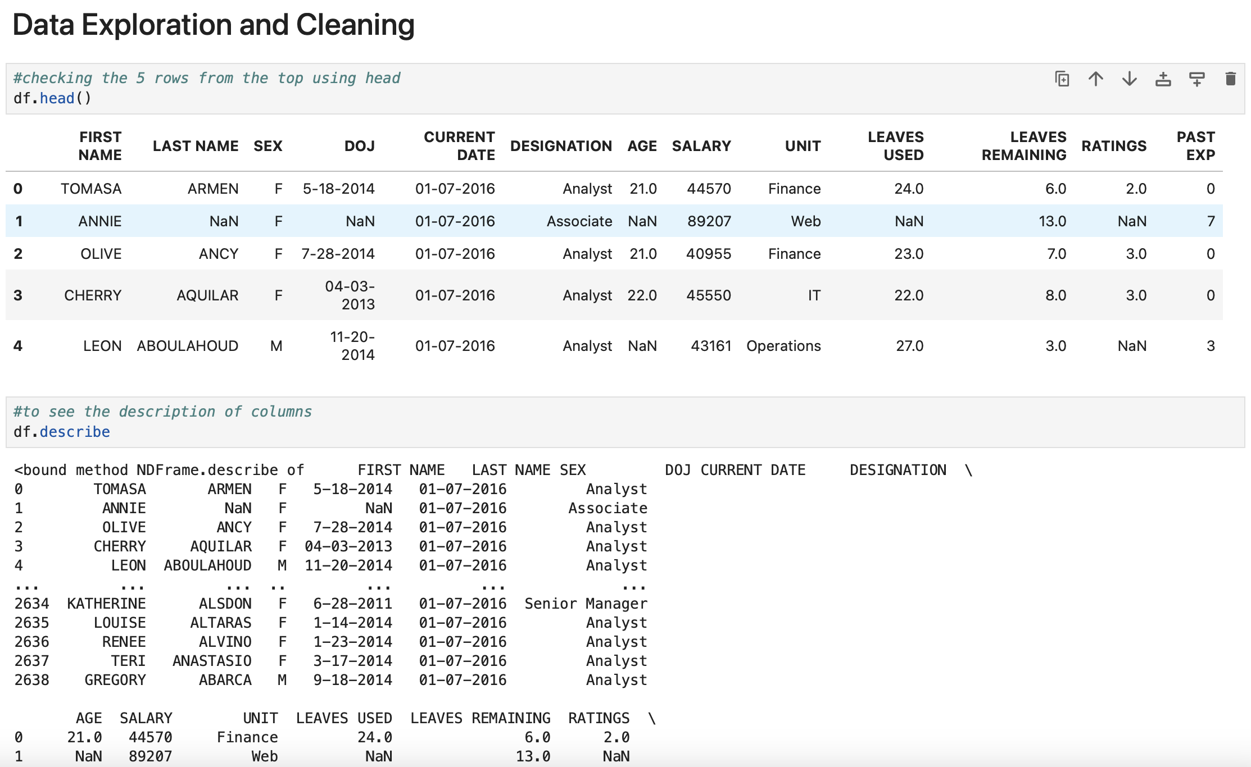
Data Exploration and Cleaning

Slide 7
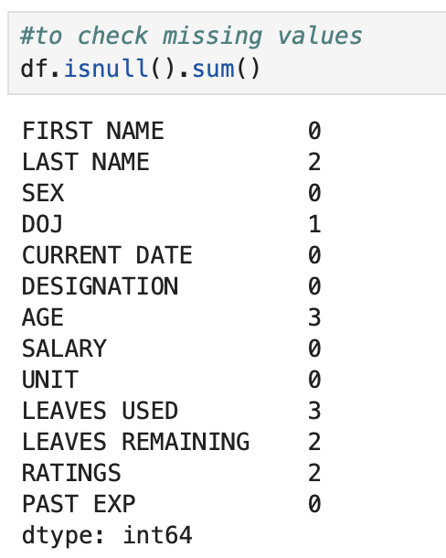
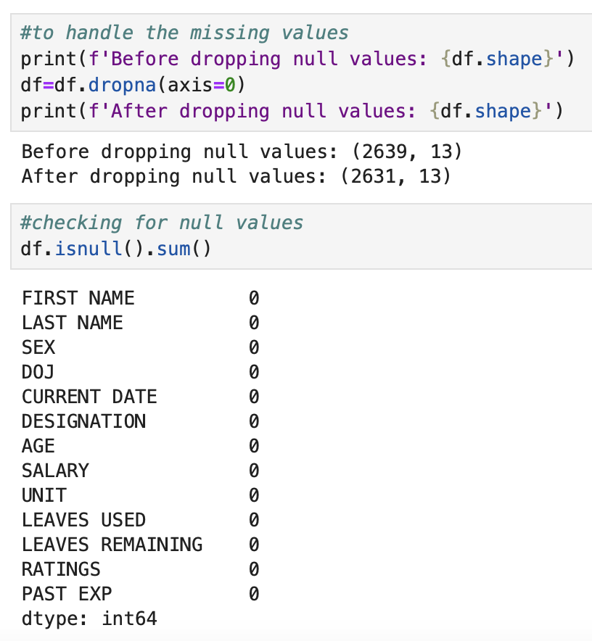

Slide 8
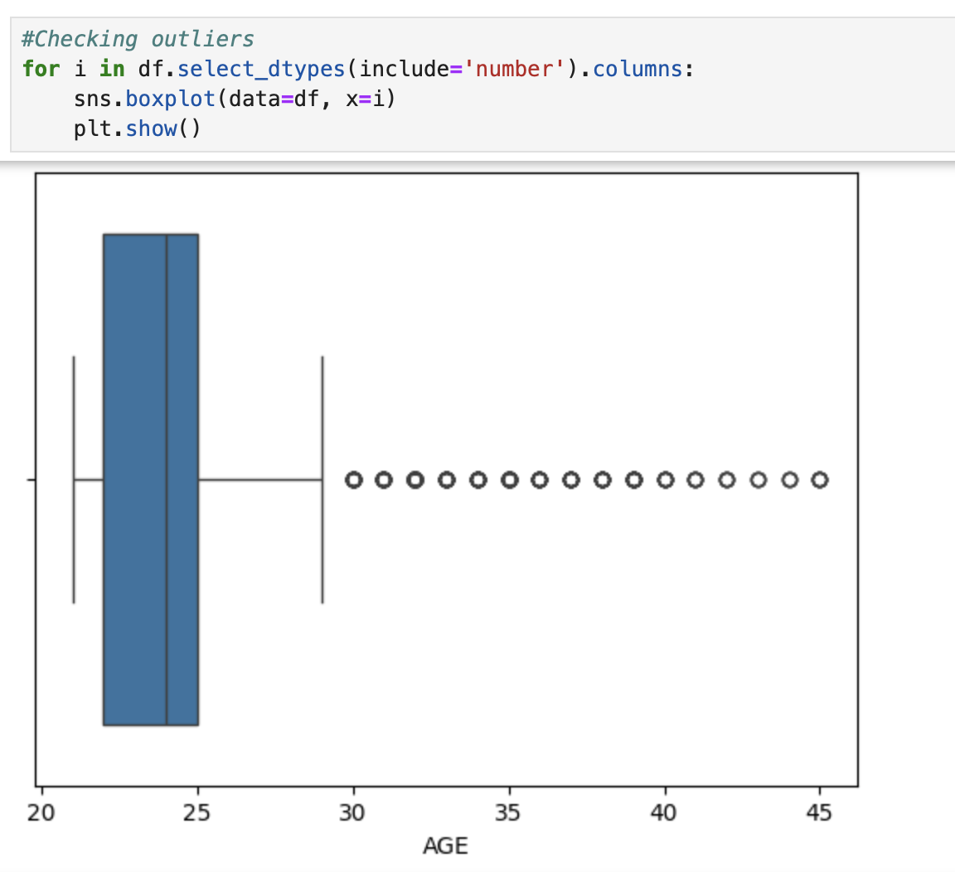
Checking for the outliers

Slide 9
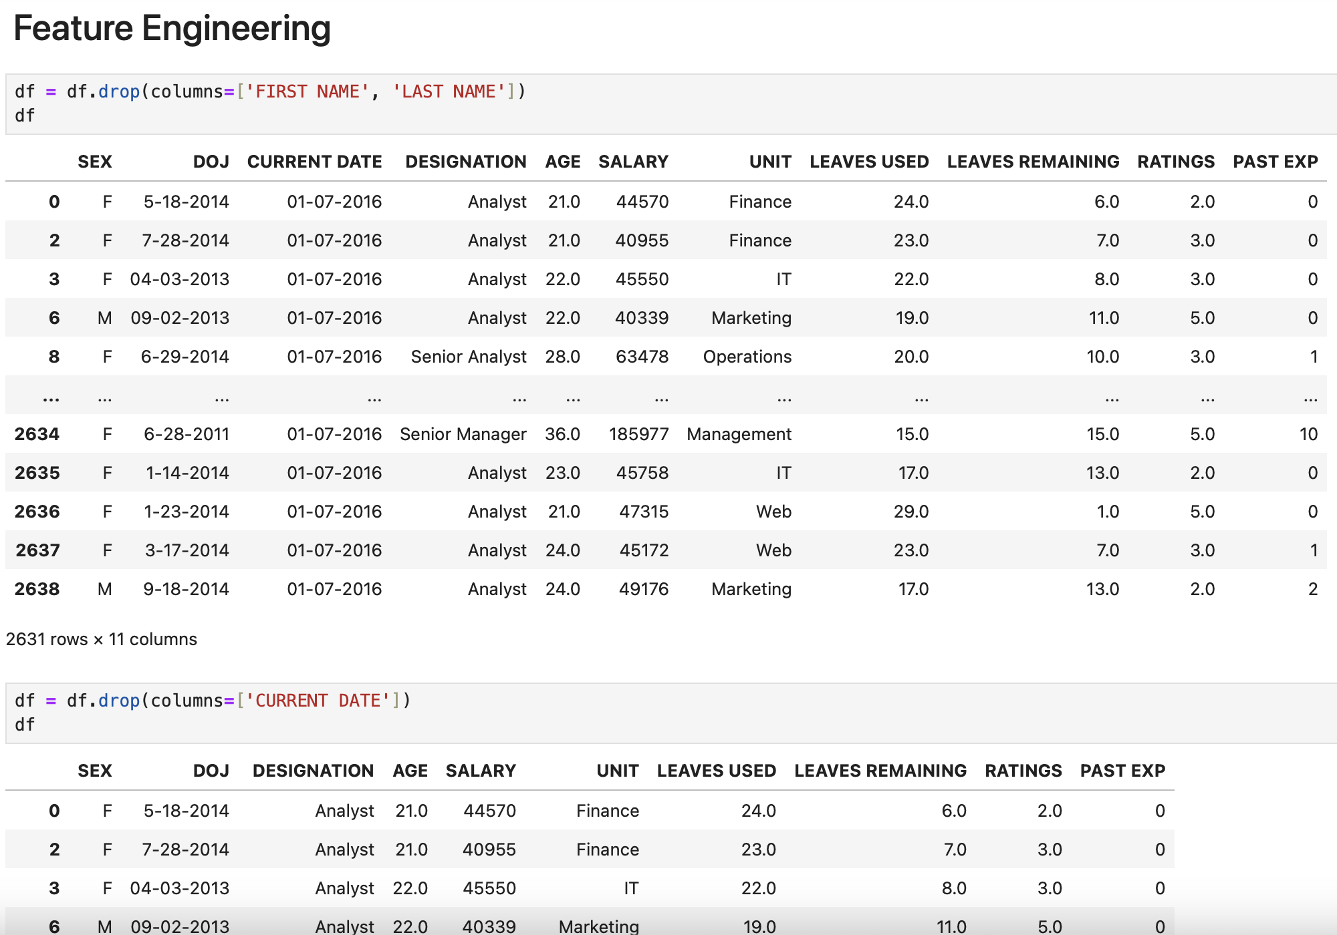

Slide 10
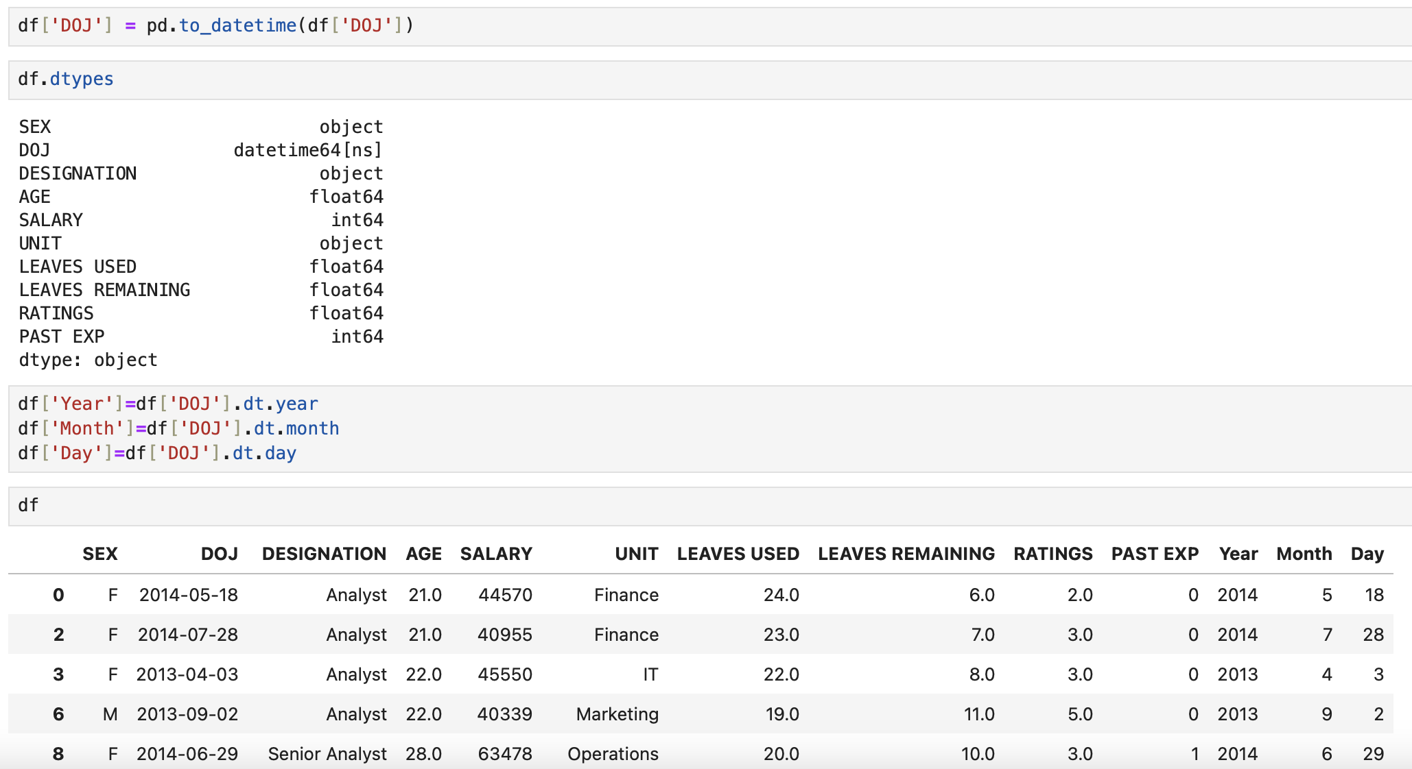

Slide 11
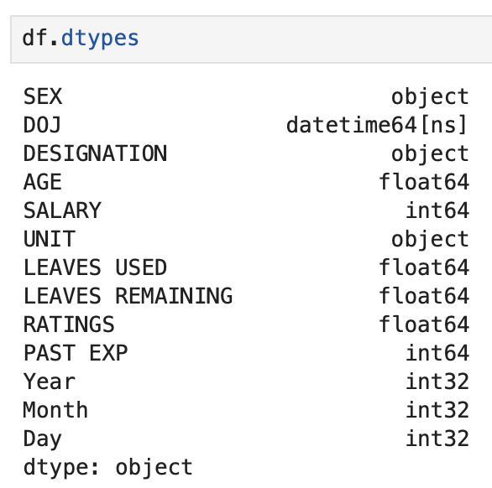
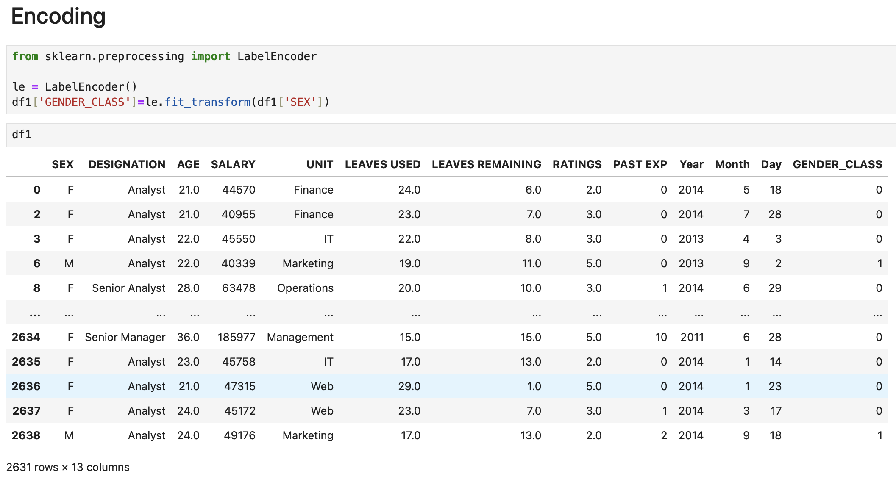

Slide 12
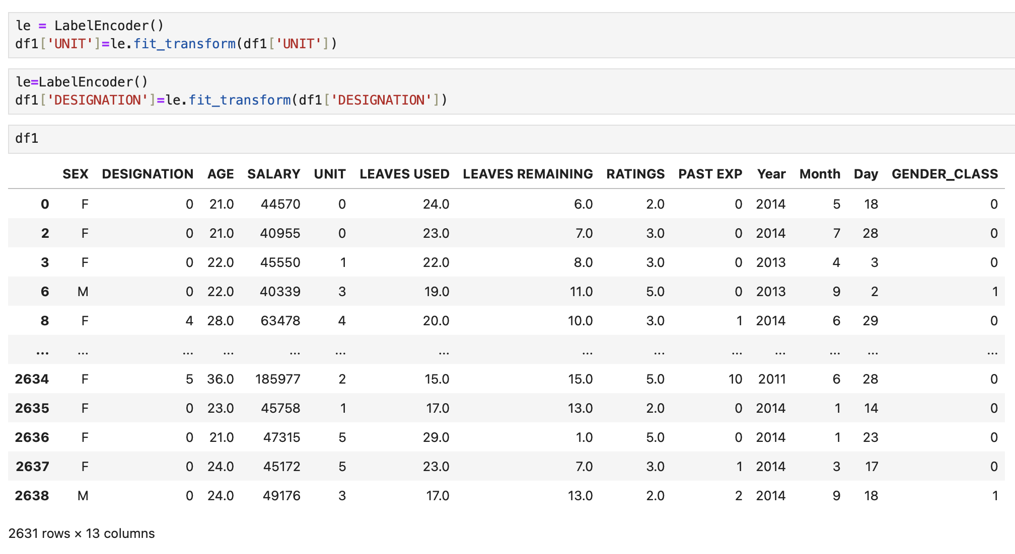

Slide 13
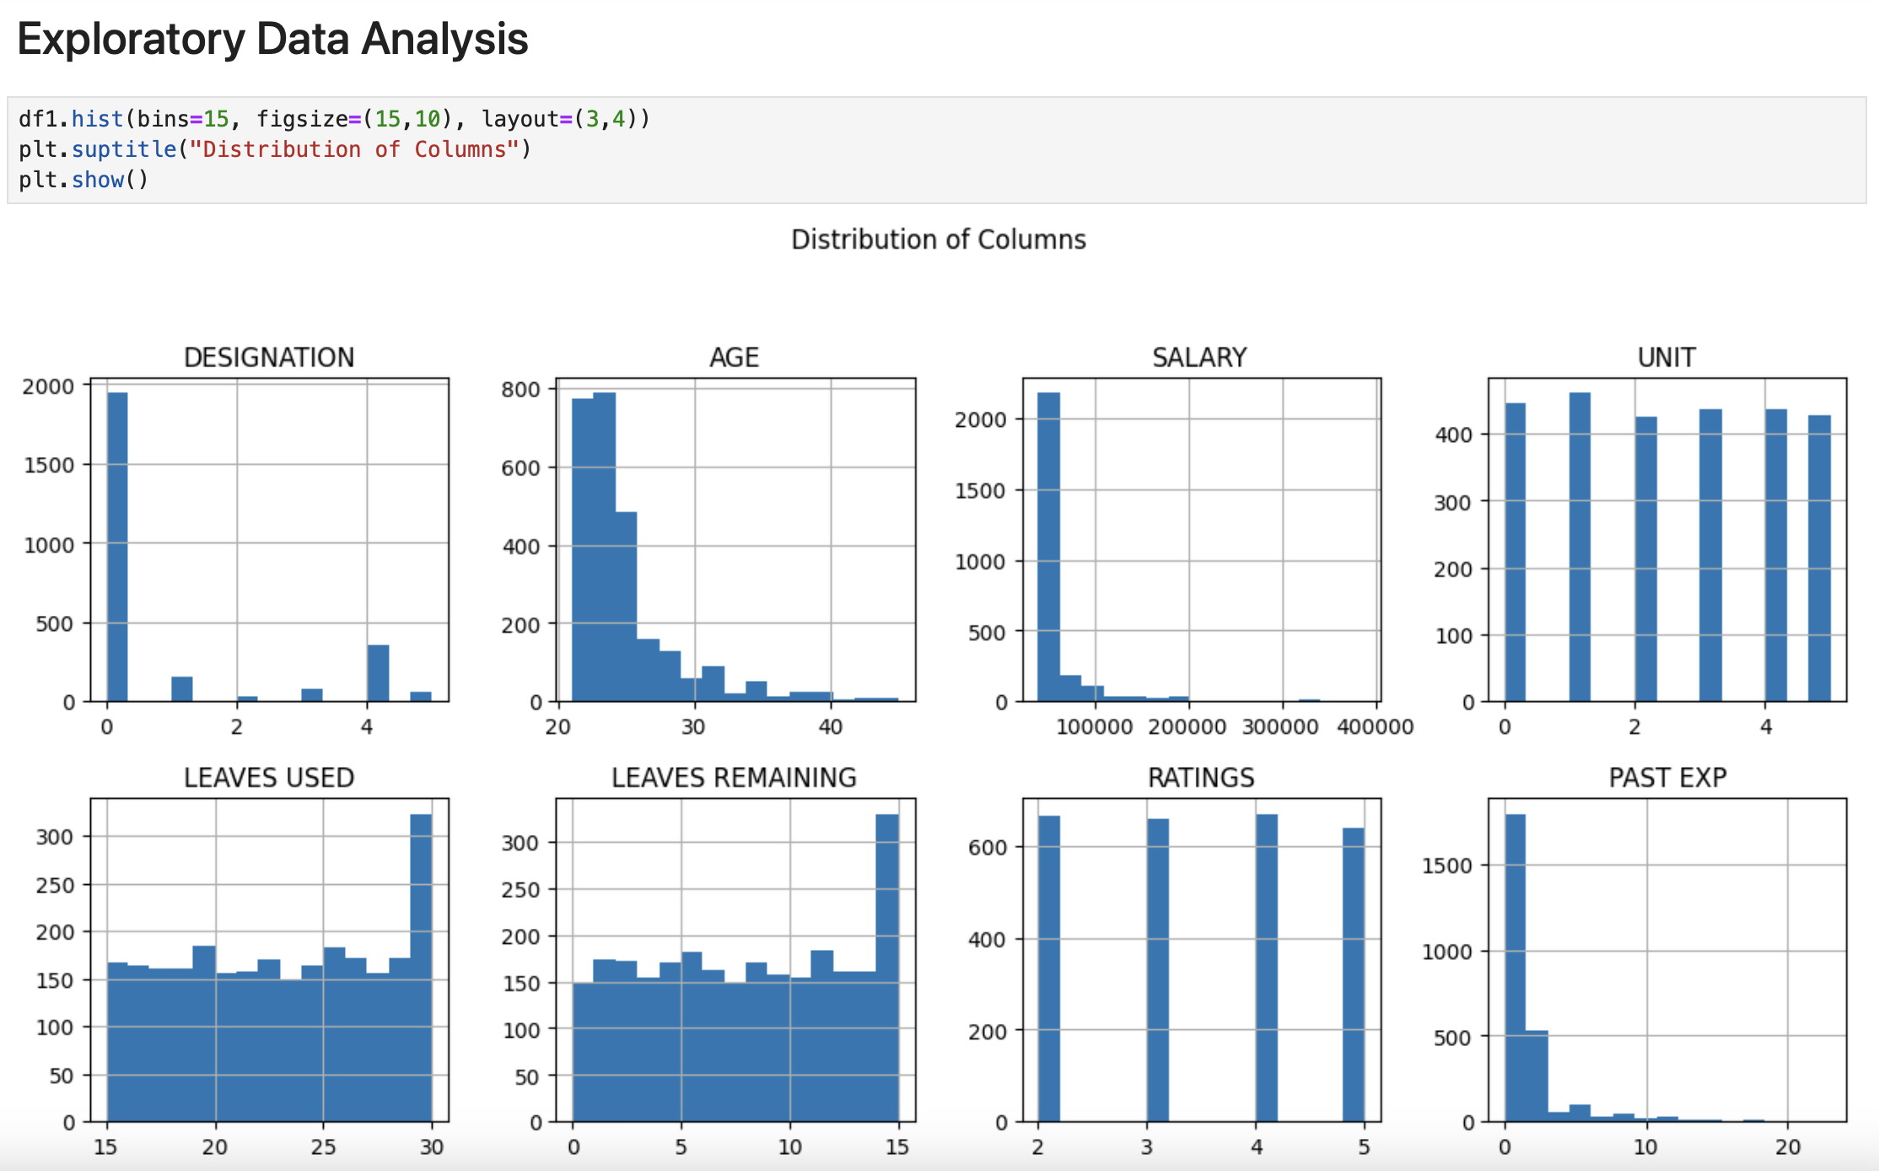

Slide 14
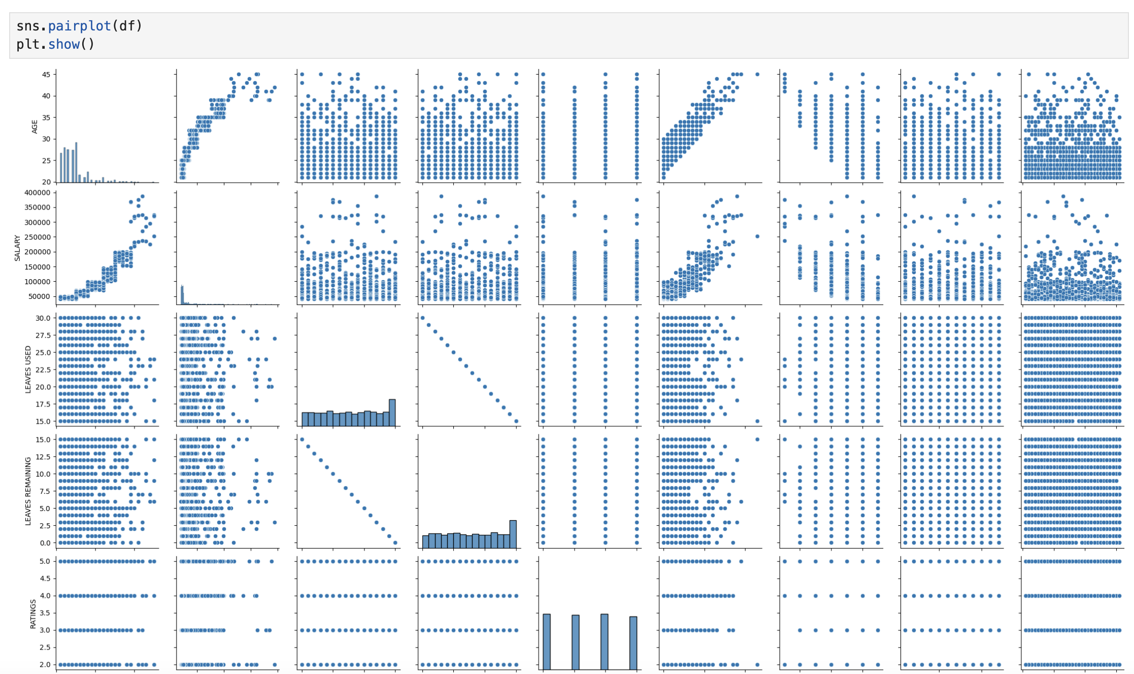

Slide 15
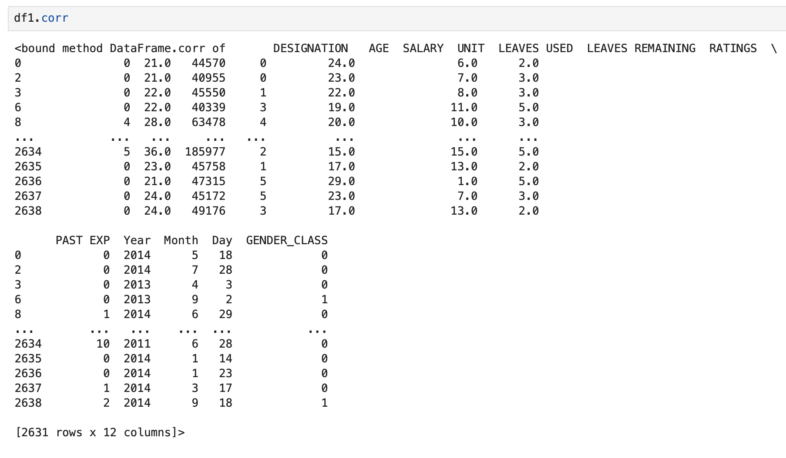

Slide 16
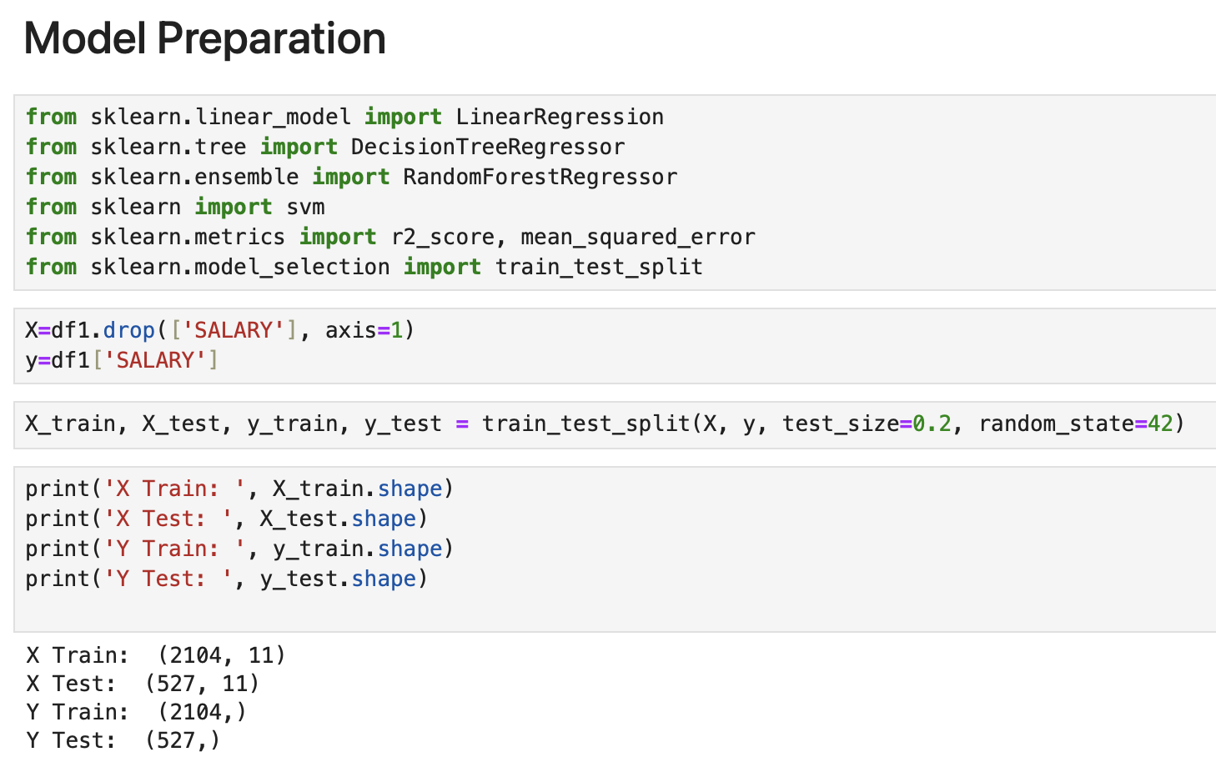

Slide 17
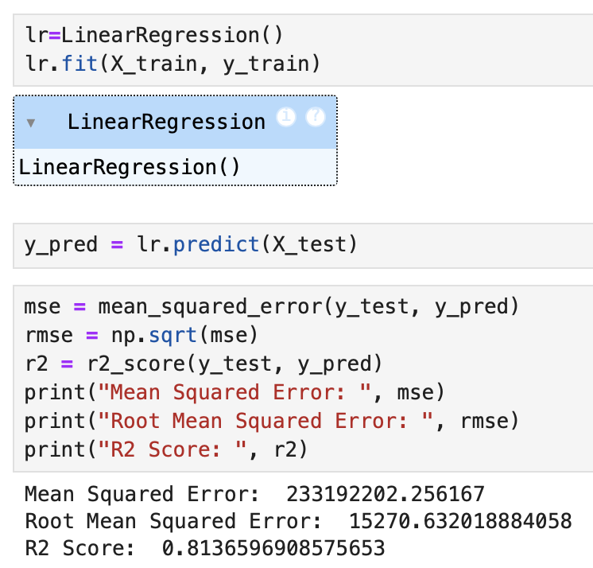
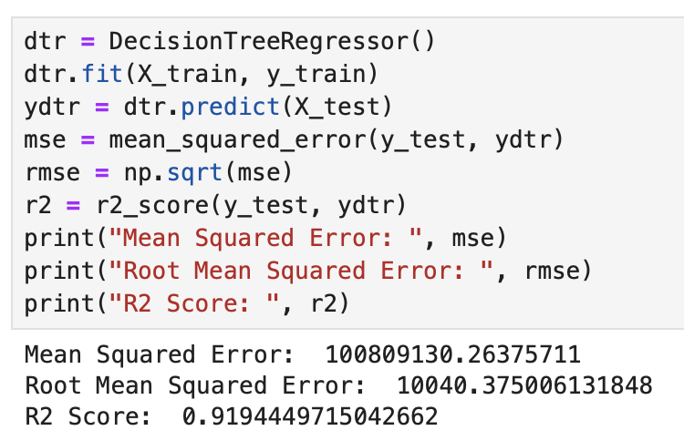

Slide 18
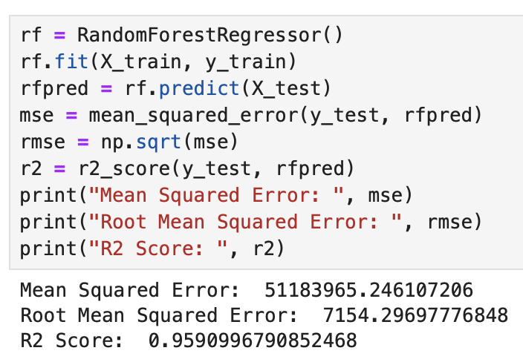
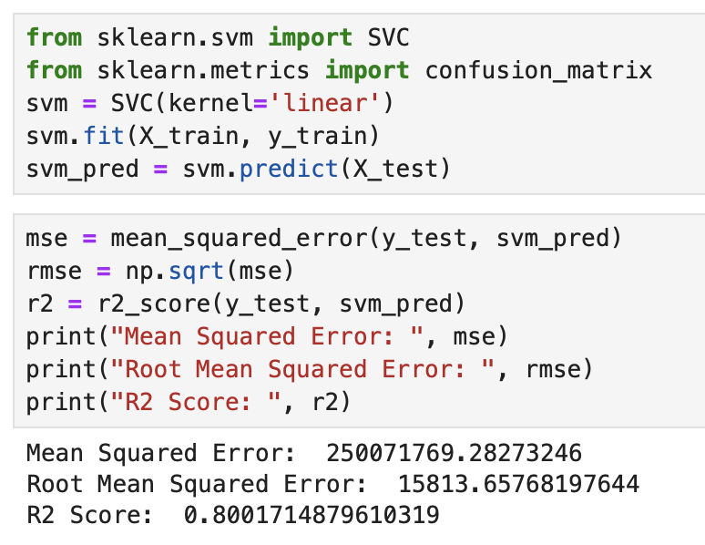

Slide 19
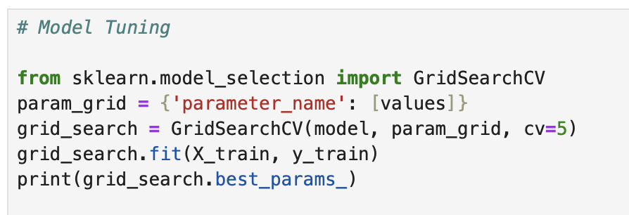
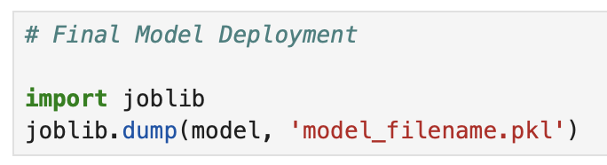
Hyperparameter tuning & Model deployment

Slide 20


